Slide 1
Context
Imagine you are apart of the American Library Association…

Slide 2


BANNED BANNED
BANNED
BANNED BANNED
BANNED BANNED
BANNED BANNED BANNED BANNED
Book Bans in the United States
ALAINA HOLLAND AND JORDYN IRWIN
DECEMBER 5, 2023
DATA TAKEN FROM PEN.ORG

Slide 3
In the past 2 years, there were ________ books banned in K-12 Schools in the United States.

Slide 4
In the past 2 years, there were ________ books banned in K-12 Schools in the United States.
5,894

Slide 5
Why should you care if a book gets banned?

Slide 6
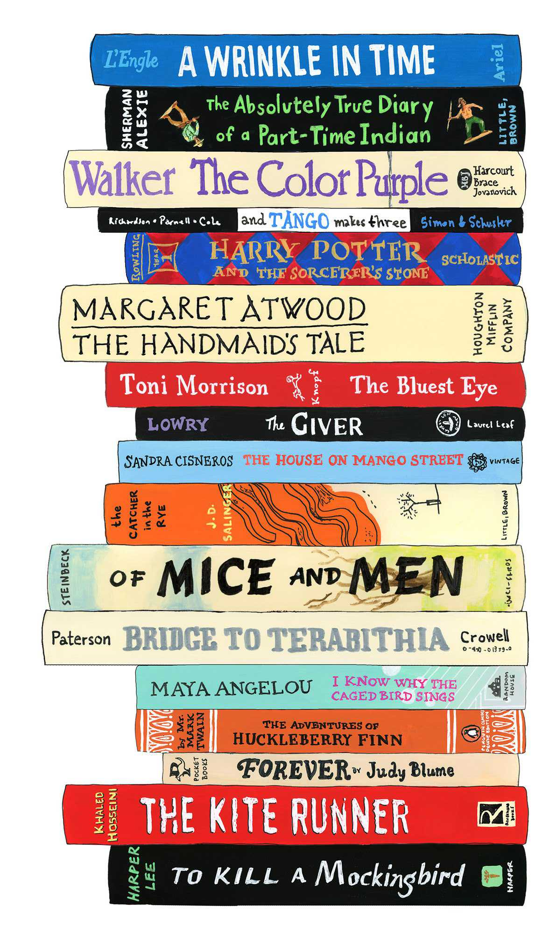
Books provide…
Access to Diversity in Education
Encouraging Critical Thinking through Exposure
Promoting Equal Access
Safeguarding Freedom of Expression
Developing Cultural Understanding
DATA TAKEN FROM PEN.ORG
Notes:
Book bans concern everyone. They affect the freedom of expression, access to information, and the diversity of ideas available to society. Readers, writers, educators, librarians, and policymakers should all care because book bans can limit learning, stifle creativity, and impede intellectual growth. They often reflect societal attitudes and can influence what future generations get to learn and understand about the world.

Slide 7

DATA
PEN America's Index of School Book Bans
Highlights restrictions on student access to books in US school libraries or classrooms
Includes: Title, Author, School District, State
Period: July 1, 2021 - June 30, 2023
Data collected each Year , Data is not cumulative
Some bans lifted, others ongoing.
PEN America's Index of School Book Bans (July 1, 2021 - June 30, 2022)
PEN America's Index of School Book Bans (July 1, 2022 - June 30, 2023)
DATA TAKEN FROM PEN.ORG

Slide 8
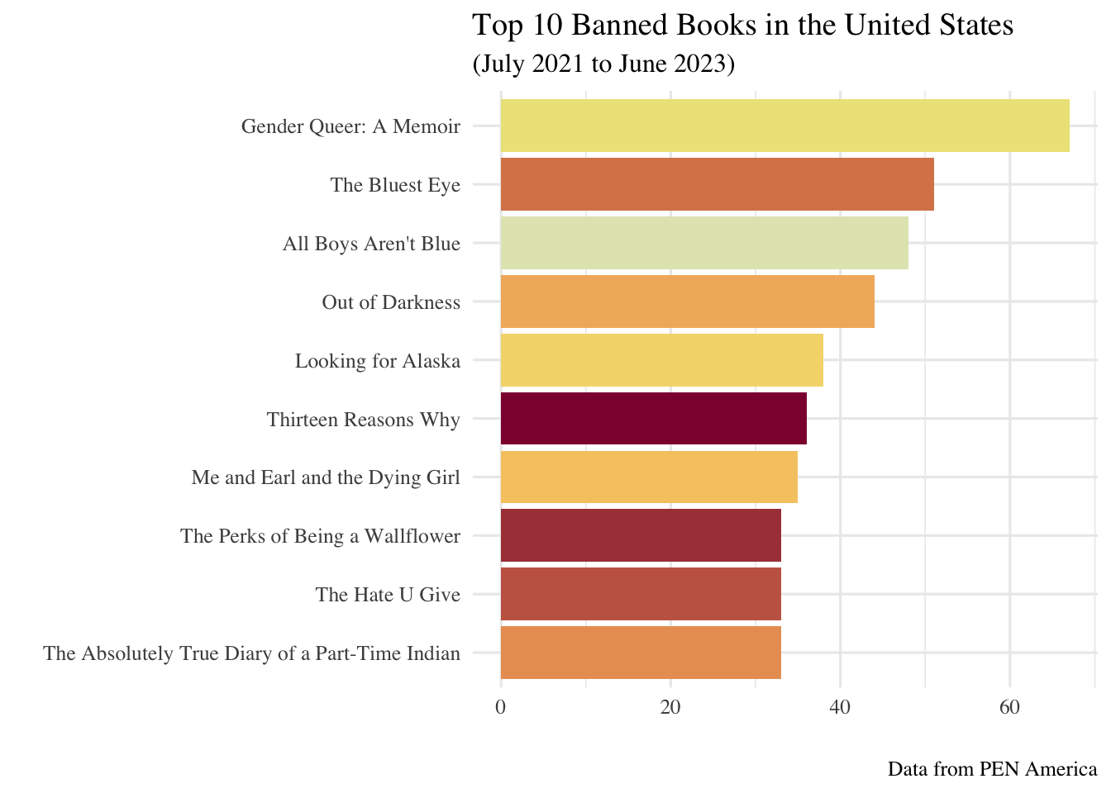
Themes
Identity
Coming-of-Age
Social Issues
Acceptance and Belonging
Friendship and Relationships
Notes:
Identity: Exploring one's identity, whether it's racial, sexual, or personal
Books like "Gender Queer: A Memoir," "All Boys Aren't Blue," and "The Absolutely True Diary of a Part-Time Indian" delve into this theme deeply.
Coming-of-Age: Many of these books focus on the journey from adolescence to adulthood, navigating challenges, relationships, and self-discovery.
"Looking for Alaska," "The Perks of Being a Wallflower," and "Me and Earl and the Dying Girl"
Social Issues: Books like "The Hate U Give," "Thirteen Reasons Why," and "Out of Darkness" tackle significant societal issues like racism, mental health, and social injustice.
Acceptance and Belonging: Themes of finding acceptance and a sense of belonging in society or among peers are explored in several of these books,
"The Bluest Eye" and "The Absolutely True Diary of a Part-Time Indian."
Friendship and Relationships: Many of these books highlight the importance of relationships,
("Me and Earl and the Dying Girl") or romantic connections ("Looking for Alaska")

Slide 9
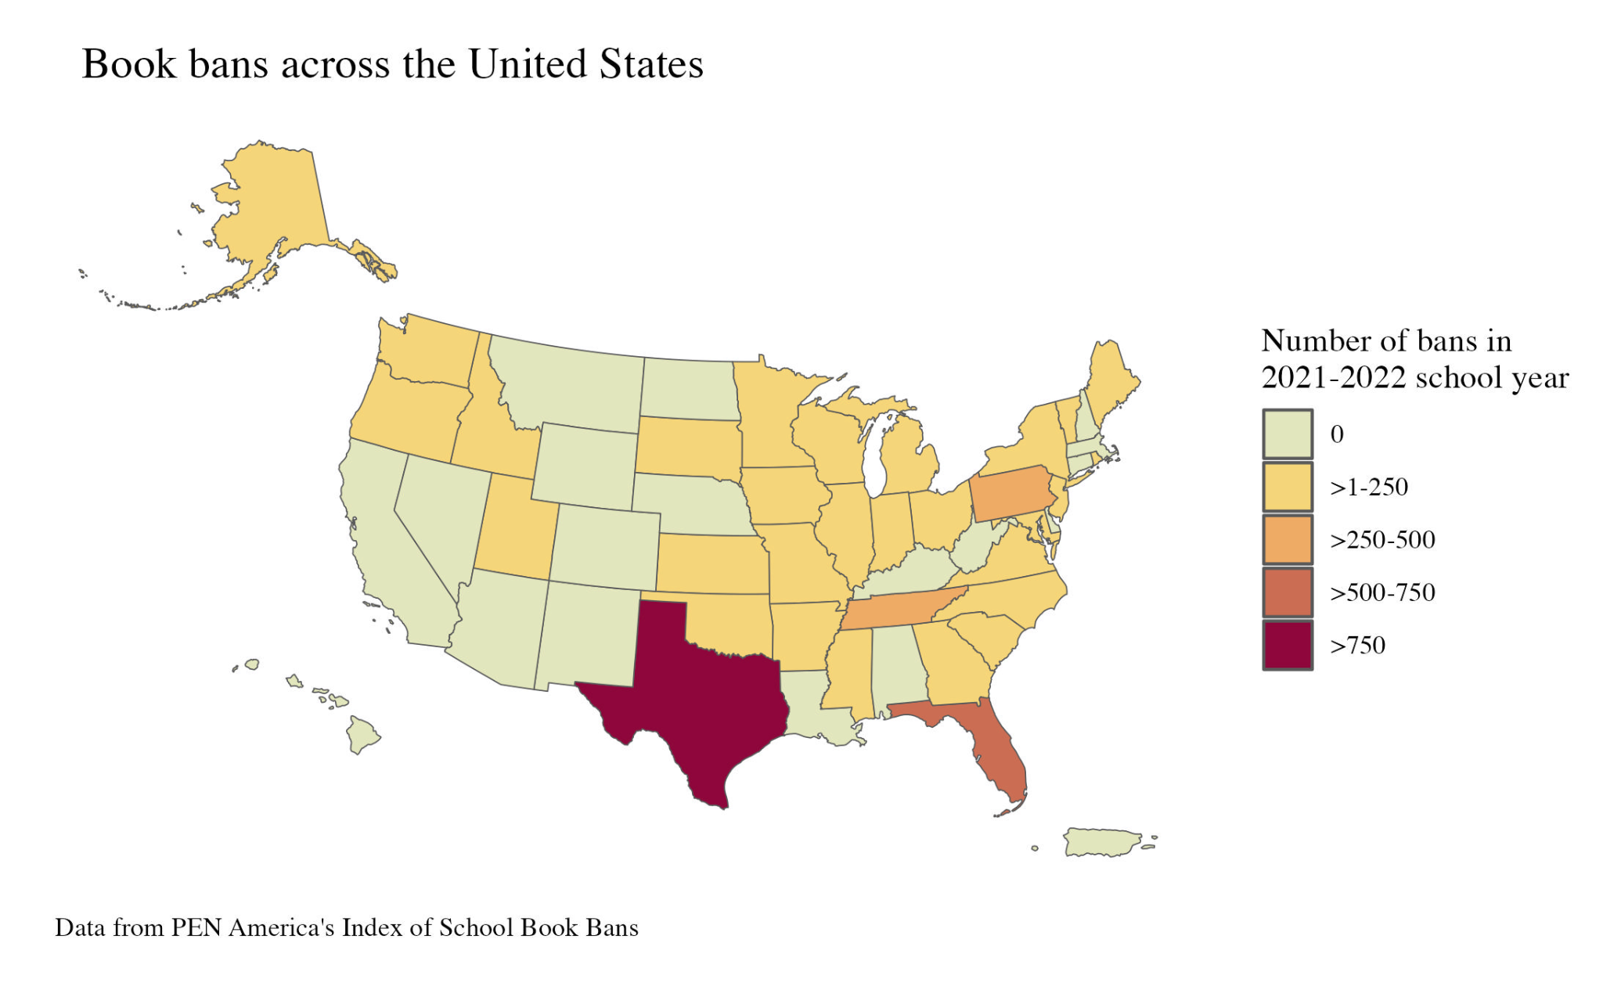

Slide 10
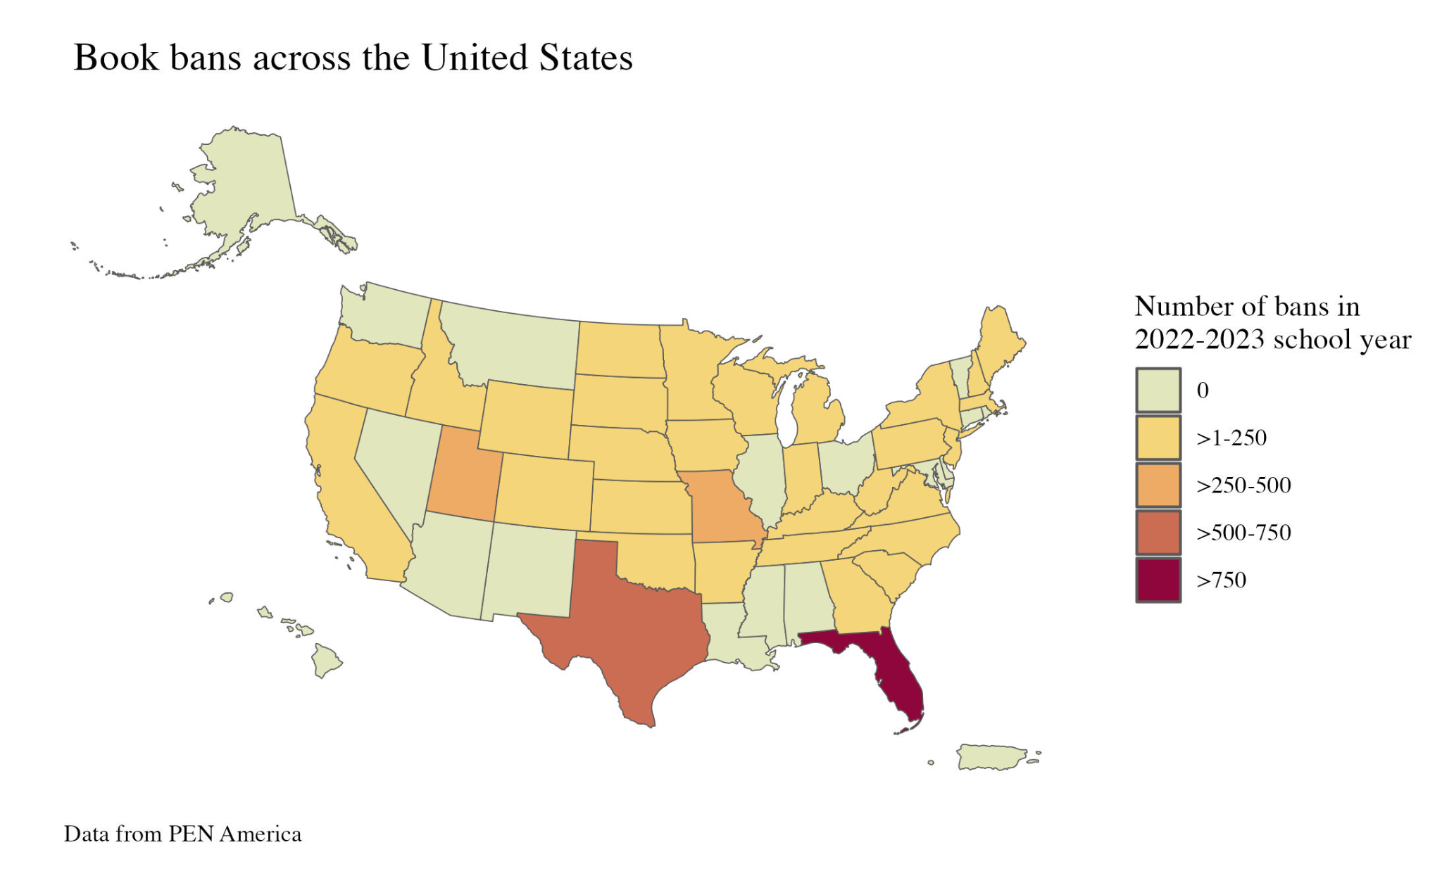

Slide 11
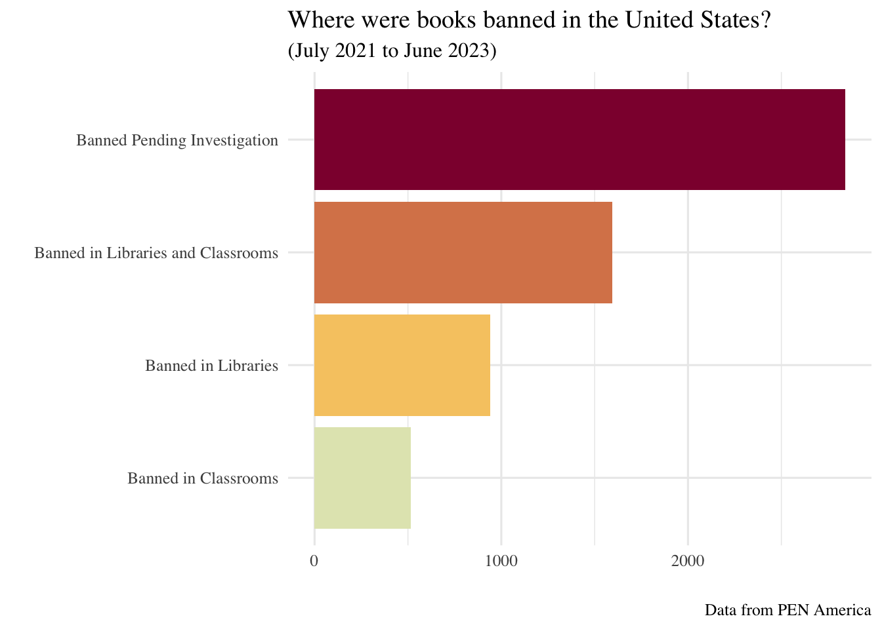

Slide 12
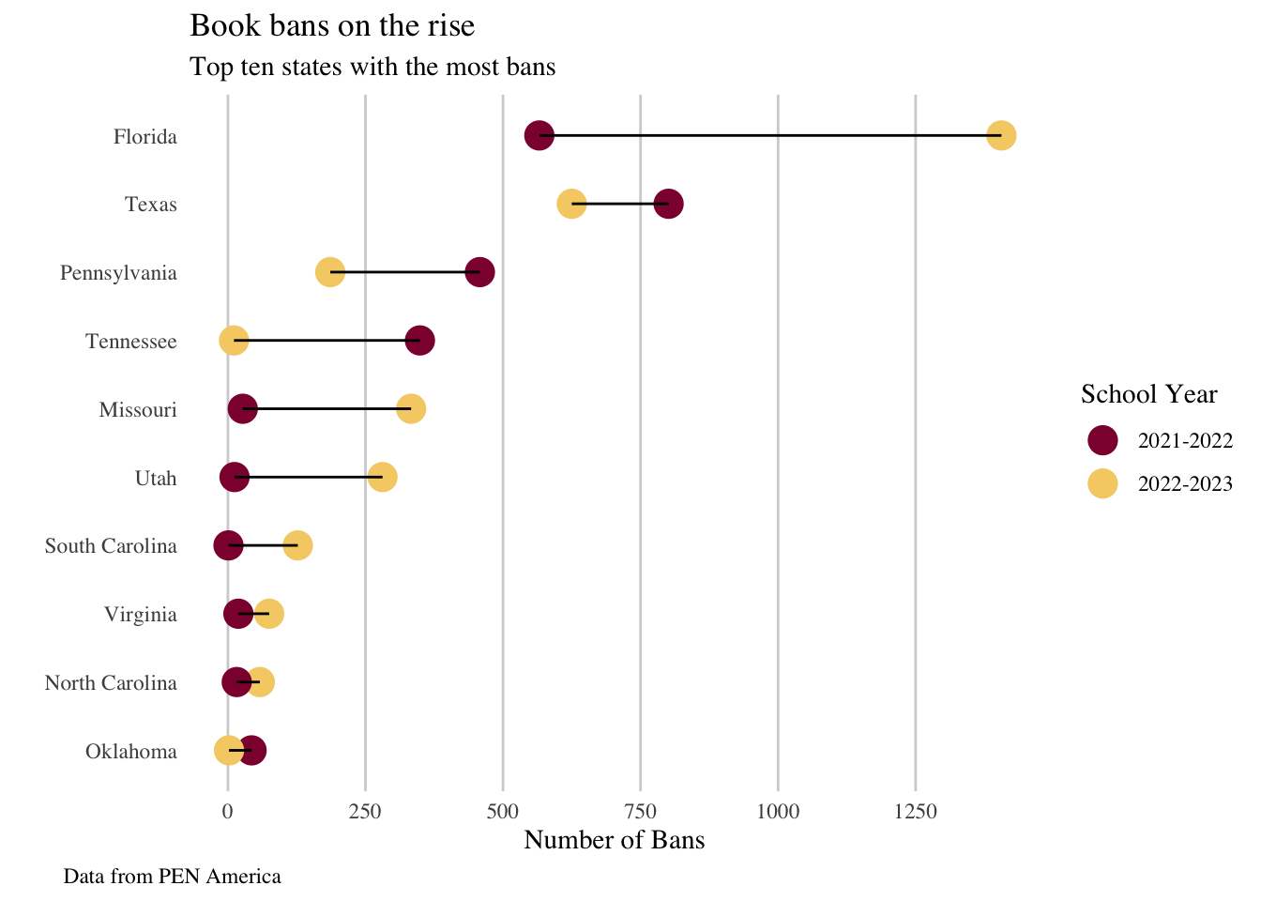
INTERACTIVE GRAPHIC: https://chart-studio.plotly.com/~aholland/1/#/
DATA TAKEN FROM PEN.ORG

Slide 13
American Library Association to create a program that allows youth under the age of 21 access to digital libraries regardless of their geographic location.
Notes:
CAL to Action

Slide 14
Questions?
INTERACTIVE GRAPHIC: https://chart-studio.plotly.com/~aholland/1/#/
DATA TAKEN FROM PEN.ORG

Slide 15
Additional Information

Slide 16
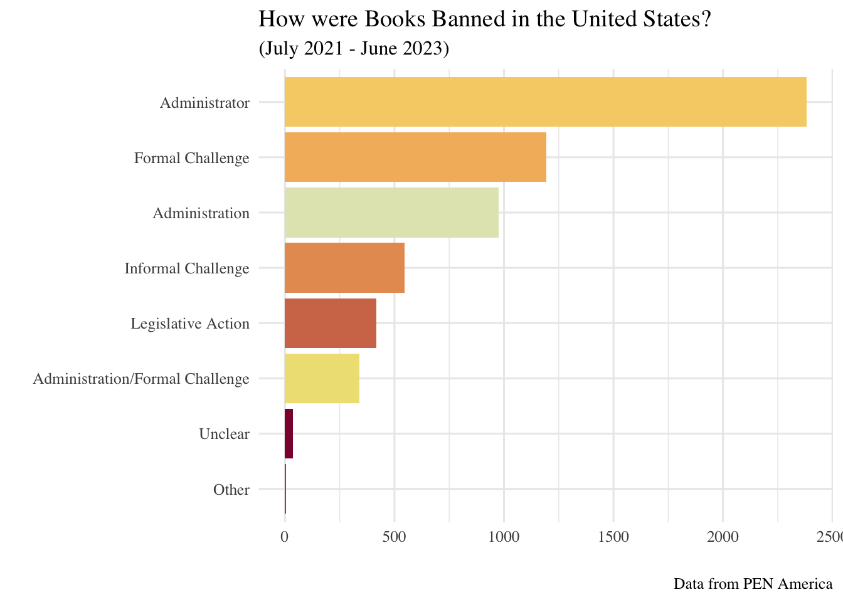

Slide 18
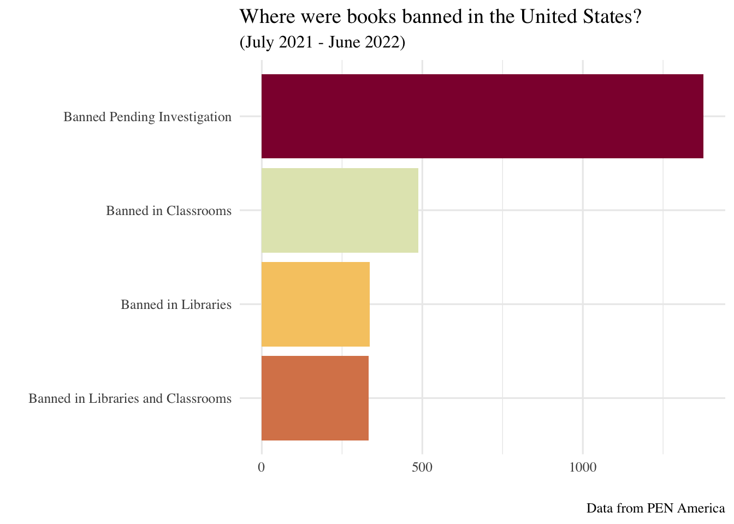
2021 - 2022
DATA TAKEN FROM PEN.ORG

Slide 19
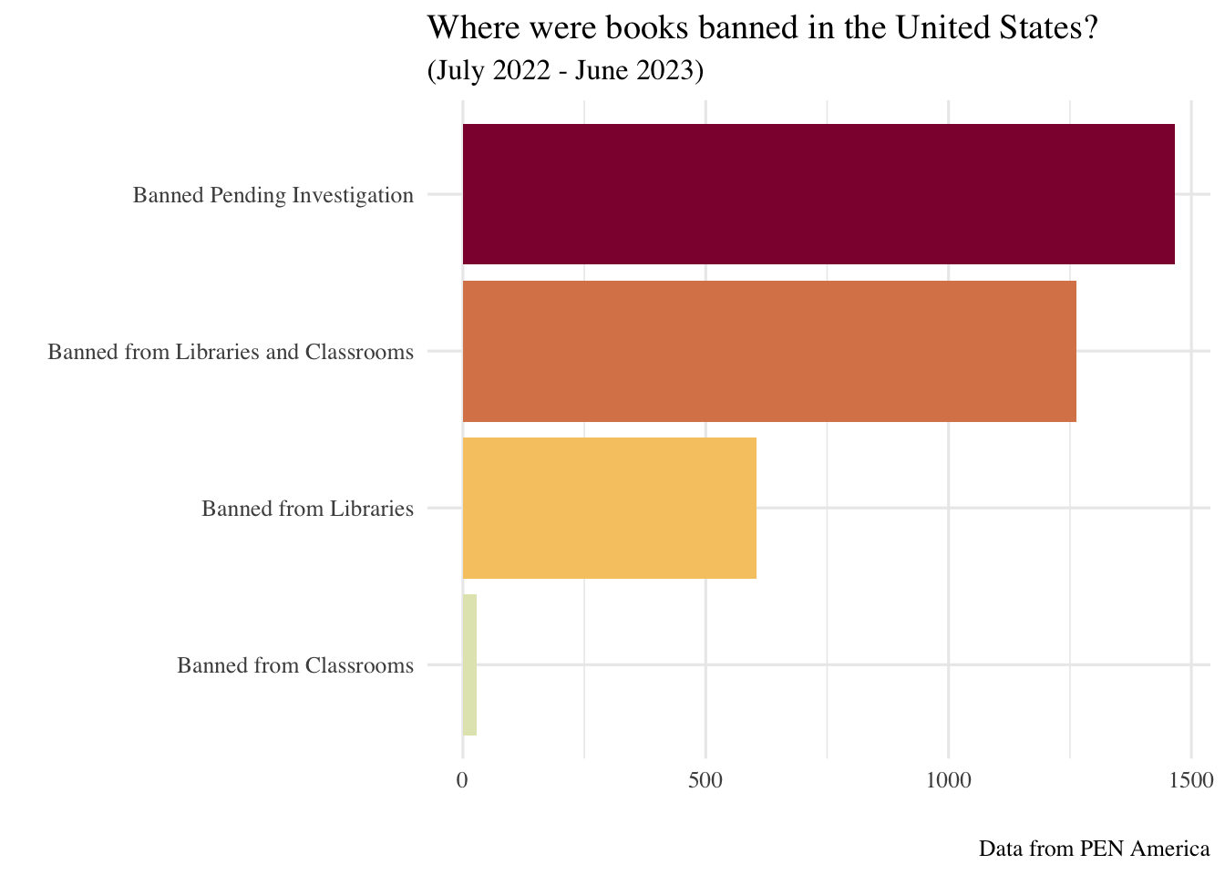
2022 - 2023
DATA TAKEN FROM PEN.ORG

Slide 20
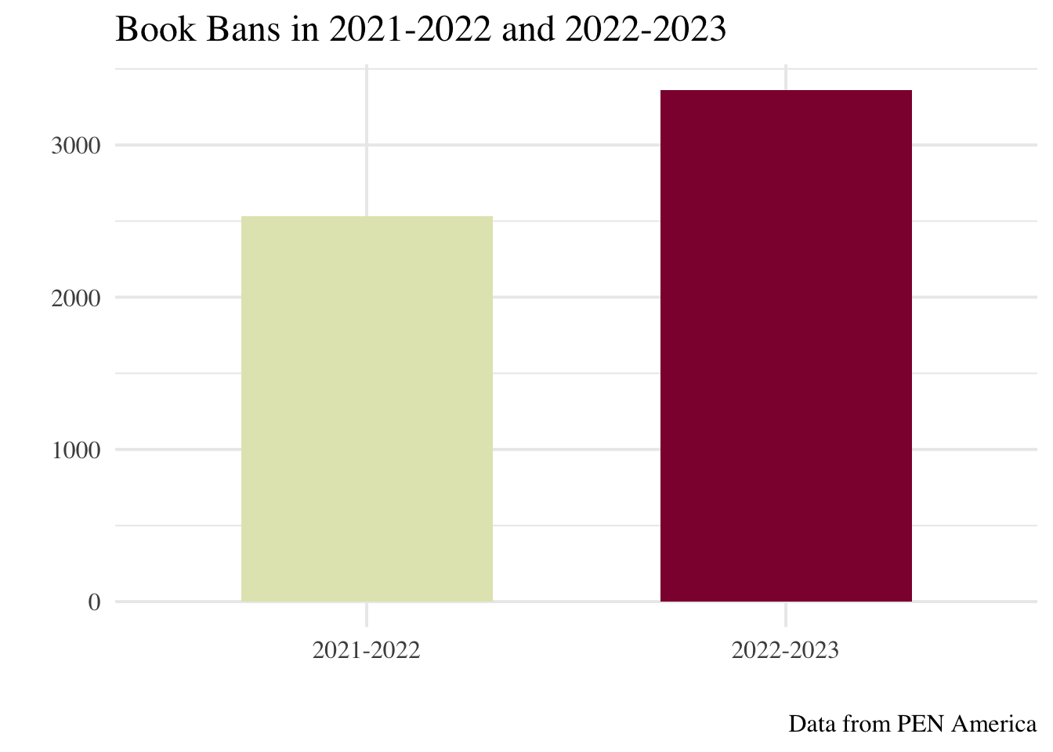
↑32.76%
Almost 1000 titles
DATA TAKEN FROM PEN.ORG

Slide 21
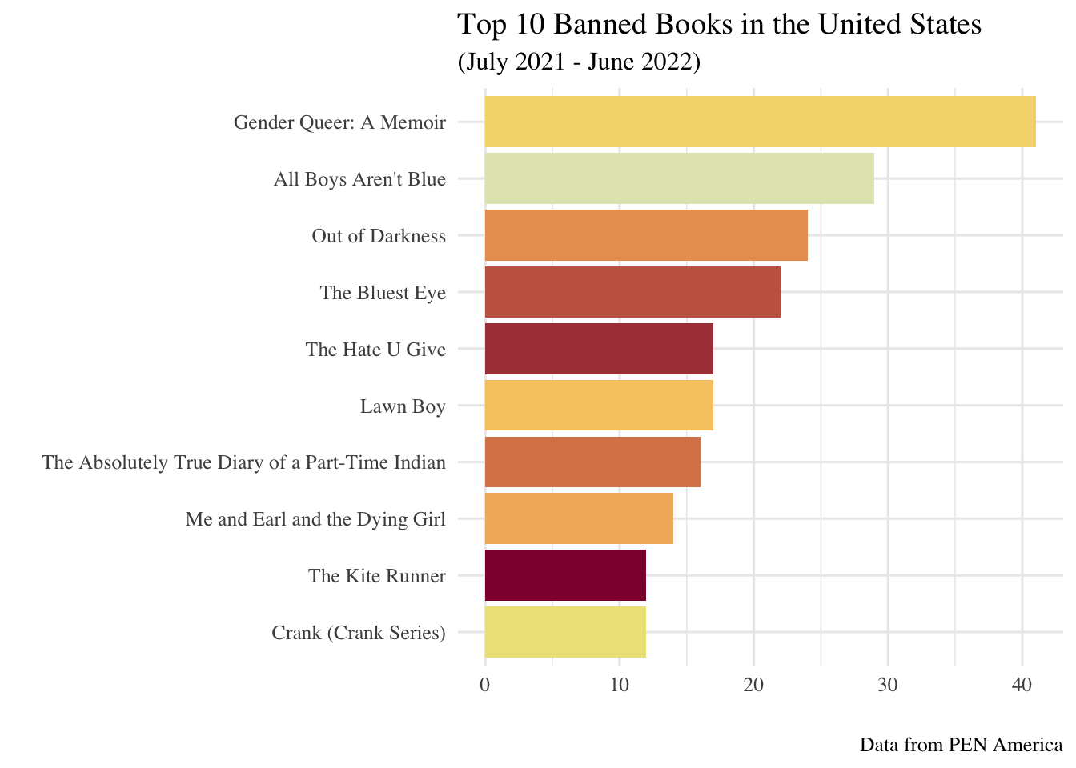
2021 - 2022
DATA TAKEN FROM PEN.ORG

Slide 22
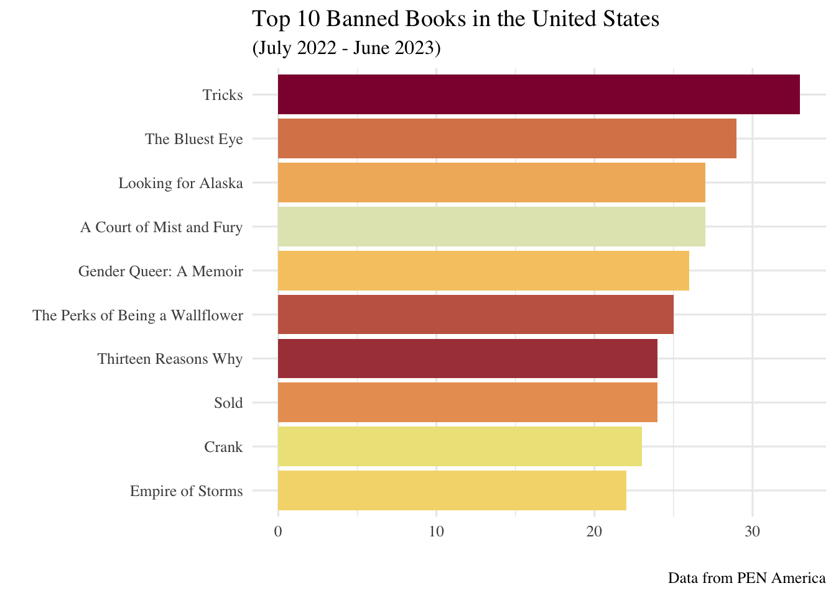
2022 - 2023
DATA TAKEN FROM PEN.ORG

Slide 23
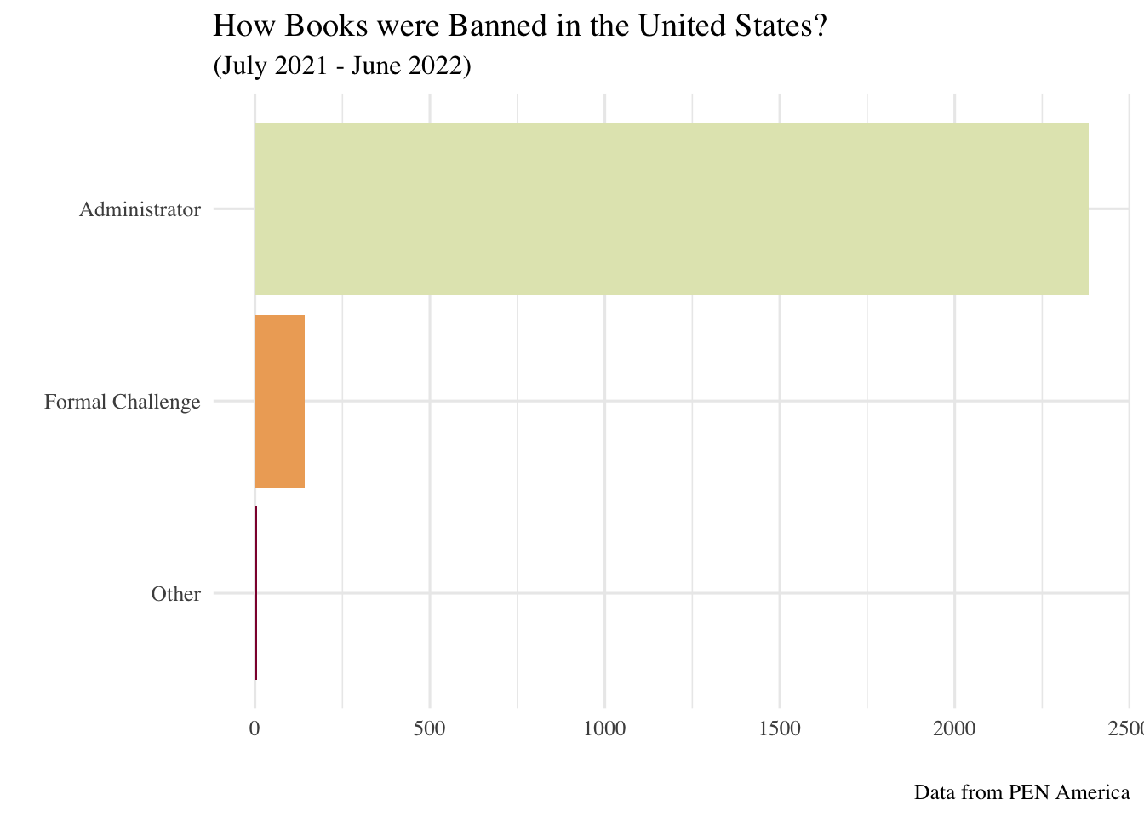
2021 - 2022
DATA TAKEN FROM PEN.ORG

Slide 24
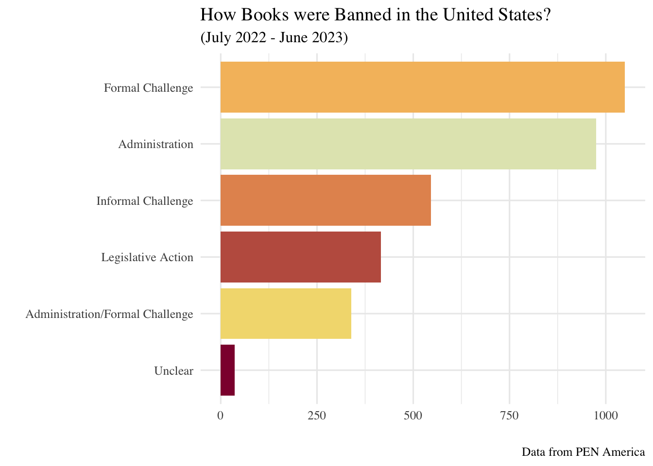
2022 - 2023
DATA TAKEN FROM PEN.ORG

